Slide 1
Reception Induction Evening
September 2025

Slide 2

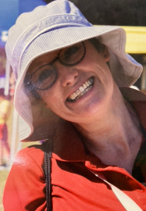
Welcome to Reception
Mr Boxall
Class Teacher / Key Person
Ms. Cox
PPA Cover Teacher

Slide 3
Welford’s Vision
Welford ‘Cares’
Creating Achieving Respecting everyone safely
‘Our vision is to inspire a lifelong love of learning within a safe, inclusive and nurturing environment empowering self-belief, respect and resilience to support our school community to reach their full potential’

Slide 4
A typical day in Reception
  8.45 Welcome, Registration, Focused Activity
  9.00 Whole class learning
  9.20 Adult led and Child initiated learning activities
  10.00 Rolling snack in groups alongside activities
  10.30 Whole class learning
  10.50 Adult lead and Child initiated learning activities
  11.45 Lunch (eat in the hall)
  12.15 Children play in small playground
  12.45 Whole class learning
  1.10 Adult led and Child initiated learning activities
  (Including guided reading)
  2.30 Tidy up time
  2.45 Story Time / Picture News
  3.00 Get ready for home time
  3.25 Home time

Slide 5
PE / Outdoor Learning Routine
Monday: PE | Come to school in PE kit.
Wednesday: PE | Come to school in uniform and bring PE kit to change into at school.
Friday: Outdoor Learning | Bring in Outdoor Learning Kit (wellies to stay at school)

Slide 6
Registration / Collection
  Reception doors will open at 8.45am for a prompt start to learning at 8.55am.
  Children are met at the bottom of the reception steps by a member of the reception team
  Children select their desired lunch by finding their name and placing it on the board (please discuss in advance)
  Any changes to the collection arrangements are to be passed to the staff member (a note is best) as we cannot release your child to anyone else at the end of the day without this.
  Have a hug, kiss and off they go. (We understand that initially, this separation may seem hard for both you and your child, but a confident goodbye reassures them they are safe and cared for).
  School finishes at 3.25pm. Please wait on the playground and children will be dismissed from the veranda steps.

Slide 7
Absence
  ‘Parents do not have any entitlement to take their children on holiday during term time.
  Any application for leave must establish that there are exceptional circumstances and the Headteacher must be satisfied that the circumstances warrant the granting of leave.
  Headteachers will determine how many school days a child may be absent from school if the leave is granted.’
  Attendance Expectations
  95% expected
  Non-urgent medical appointments out of school hours
  Late – register at the school office
  What to do if your child is sick?
  Call the school office and give a brief description of why your child is not attending school by 9.00am.
  Please read the school policy on administering medicines at school (school website).
  Sickness and diarrhoea – Your child must not return until 48hrs following the last bout.
  If your child has needed to be administered Calpol or similar before school, they are not seen as fit for school.

Slide 8
School communication
  If you have any questions or queries about your child you can contact me by:
  • Writing a note in your child’s reading record / tape it on the front of the book bag
  • Leave a phone message which will be returned at the end of the school day
  • Make an appointment through the school office
  • Email the school office (not teacher’s email)
  Please do not use my email or Teams to contact me. Teacher emails and Teams are not intended to be used to communicate with parents as they are not regularly checked and messages might be missed. Teams should only be used when learning remotely.
  You may wish to phone or email the school office and your message will be passed on and responded to at the end of the school day. Thank you for your understanding.
  In return we will keep you up to date in the following ways:
            Weekly whole school newsletter / Reception newsletter
            Direct email / letter from the school office
            School website / social media

Slide 9
Our learning environment
  We come to school to learn. We will have fun and make friends however, the focus is on learning. Therefore when describing our learning environment we use specific vocabulary.
  Engaging – Interesting – Safe
  Each area has a clear limit to the number of children who can be there. This is to ensure safety and focus for all.
  Indoor learning areas:
  Classroom
  Sports Hall
  Library
  Veranda
  Outdoor learning area
  Outdoor classroom* (within the red fence)
  Forest School
  School Playing Field / Monster Playground
    *Our outdoor classroom is different from your garden at home. We discourage running, shouting, fighting or building weapons using the equipment. Outdoor learning will take place during various weather conditions throughout the year (where safe) therefore correct uniform must be provided.

Slide 10
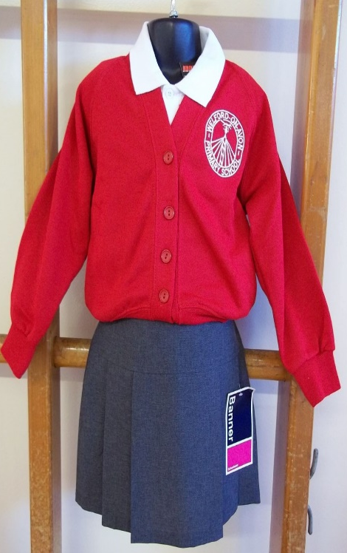
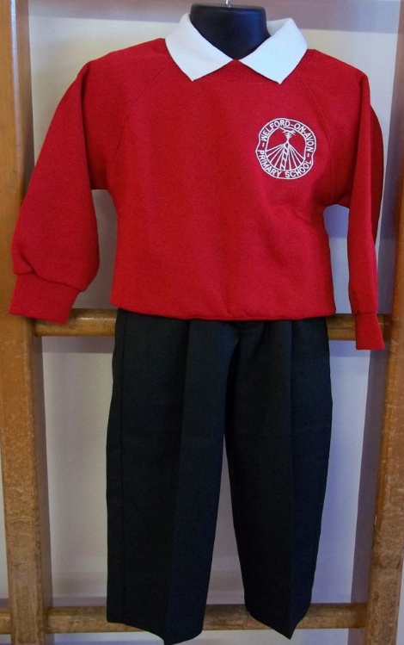
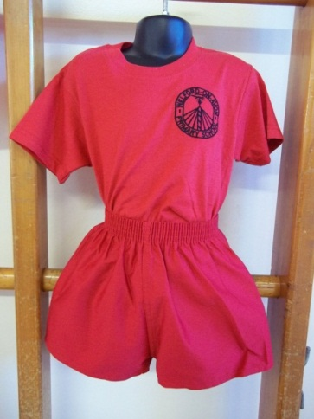
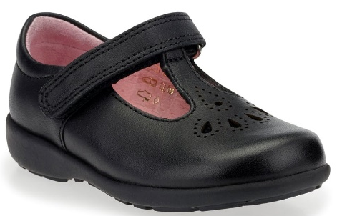
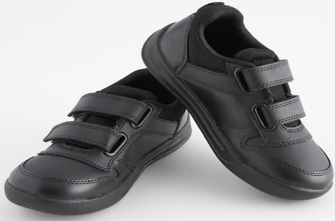
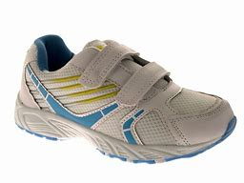
Uniform
The school uniform colours are bright red, grey and white. Sweatshirts are in red, polo shirts in white. Children should wear either long or short grey trousers, a grey skirt or pinafore – with the option of a dress in the summer.
Sensible school shoes should be worn for comfort and safety (no boots).
For PE: Red Shirts and shorts in red/black which are available from The National School Wear Centre, Alcester. In addition, your child will need a PE bag (backpack) and trainers for PE.
Parents are asked to ensure that their children conform to the dress code at all times.
We request that all items of school uniforms are clearly labelled with the child’s name.

Slide 11


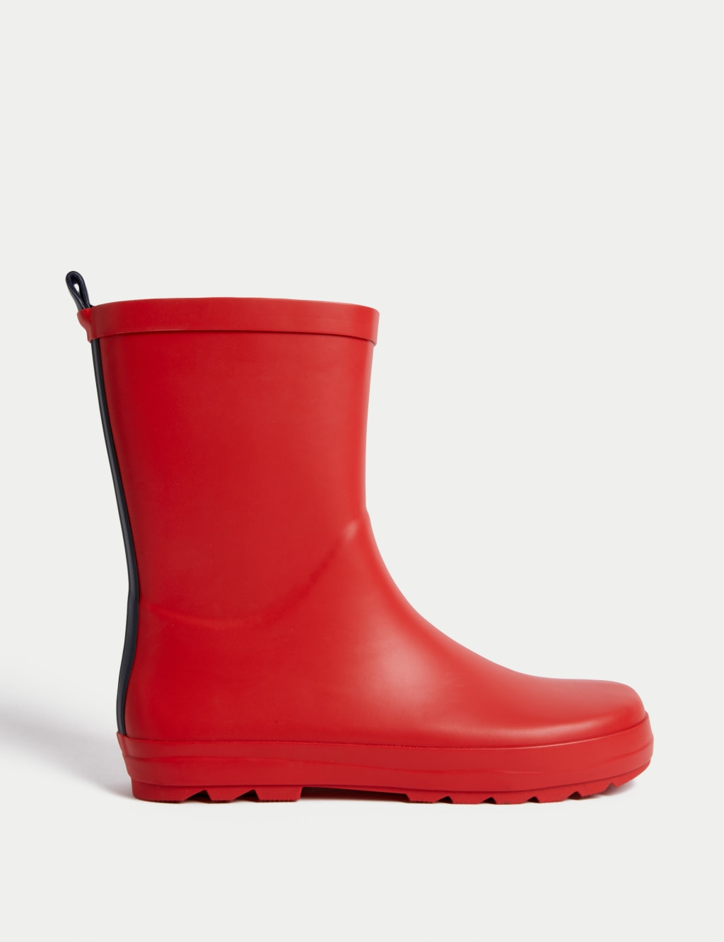
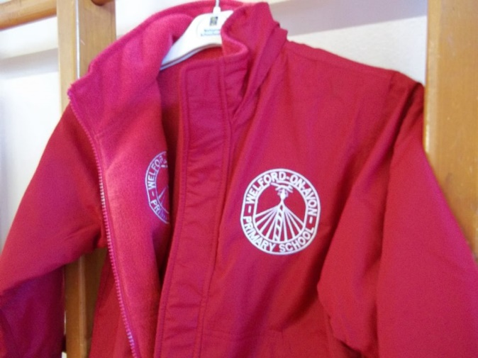

Uniform
Additionally, your child will need the following items:
Legionnaire-style hat– to be left at school
Wellington boots – to be left at school
Sports cap water bottle ( water only) (with name on)
Coat (suitable for the weather)
Red school book bag (no additional bag / rucksack)
Art Apron (old shirt that buttons at back)
Each item must be clearly labelled with child’s name.

Slide 12

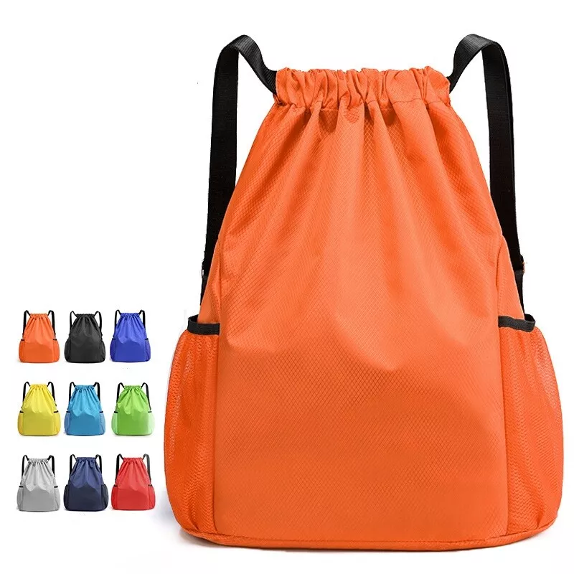
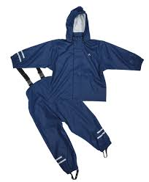
Forest School Uniform
Waterproof leggings and coat / waterproof puddle suit
All items are to be in a named bag (on the outside)
In the winter children to bring in gloves and scarves.
A fleece or jumper can be worn underneath.

Slide 13
EYFS Framework
The EYFS framework outlines seven areas of learning.
There are three prime areas of learning, which are particularly important for your child’s development and future learning:
  Communication and Language
  Personal, Social and Emotional Development
  Physical Development
  There are four specific areas of learning, through which the prime areas are strengthened and applied:
  Literacy
  Mathematics
  Understanding the World
  Expressive Arts and Design
  At the end of the reception year, children are assessed against the 17 Early Learning Goals*
  *These are not a test. Staff will use what they already know about a child to make their assessment decisions.

Slide 14
Little Wandle Phonics
  This is a systematic, synthetic phonics scheme that we have chosen as a school (Nursery – Year 2)
  How does it work?
  Focuses on ensuring all children become confident with using their phonic knowledge to read words.
  Similar structures to lessons and activities to reduce cognitive overload so children can focus on the sound (phoneme) made by the written letter (grapheme).
  Through confidence in phonics knowledge children can develop to be confident readers (blending phonemes together) and spellers (segmenting and recording the phonemes they have heard).

Slide 15
Learning to read
  In guided reading, we read the same text three times during the week before your child brings the book home. This allows us to review phonemes and tricky words that will be in each book.
  Each week your child will bring home the phonically decodable book they have shared at school.
  On book change day they will be given additional phonically decodable or picture books to share with you at home.
  It is one of our key aims to teach children to read, but as parents, you can help support this development:
  Encourage your child to point, sound and blend with a view towards reading fluently.
  Use ‘pause, prompt and praise’. Wait before correcting mistakes so your child has the opportunity to correct themselves.
  Give clues to help them get words correct and remind them of phonemes / tricky words they learnt.
          (Some children will need lots of practice and others will want to read the same book again and again. This is a normal part of learning to read).

Slide 16
Communication and Language
  Children will be encouraged to communicate positively throughout the school day.
  We encourage children to speak in full sentences to communicate their wishes.
  This will be achieved through various opportunities but not limited to:
  Talking and listening to others (whole class, groups, 1-1)
  Guided reading
  Whole class story time
  Singing
  Assemblies

Slide 17
Physical Development
  The development of gross and fine motor skills (strength and dexterity) will be supported in multiple ways:
  PE Lessons (days to be confirmed in September)
  Dough Disco / Squiggle While You Wiggle / Flipper Flappers
  Balance Bikes
  Scooters
  (this list is not exhaustive)

Slide 18
Personal, Social and Emotional Development
  There is a wealth of opportunity for your child to develop their PSED at Welford on Avon Primary School.
  As well as day-to-day opportunities there are annual events that our children eagerly await:
  Christmas Nativity
  Learning Assembly
  Class Assembly
  Maypole Dancing
  Sports Day
  Wellbeing Day
  World Book Day
  Cake Sale
  Trips
  Pantomime
  Visitors

Slide 19
Assessment in the Early Years Foundation Stage
  Learning journals are kept as a record of your child’s progress in Reception
  Assessments take account of contributions from a range of perspectives including children, parents and other adults.
  Child-initiated play is important, alongside taught or adult-led activities.
  Exercise / workbooks.
  Class floor books / displays
  You will be informed of your child’s progress at parents’ evenings and any areas for development.
  We will always let you know if we have any concerns.

Slide 20

How can I help my child be ready for Reception?
  Being ‘school ready’ isn’t just about being able to hold a pencil correctly. It is about enabling your child to build independence. It would be really helpful if your child could start school being able to:
  Put on and take off shoes
  Use the toilet independently (including flushing the toilet and washing hands)
  Use a knife and fork
  Dress and undress ready for PE
  Fold and stack clothes
  Tidy toys away
  Play with other children and share possessions
  Blow their nose
  Carry their book bag
  Zip up their coat
  But, do not worry if they can’t, YET.
  Useful links:
  https://shorturl.at/NmSmh

Slide 21
The Big Day
  Prepare your child by talking about happy events you remember when you were at school.
  Talk about:
  School routines (start of the day, register, playtime, lunchtime, end of the day)
  Different types of lessons (writing, reading, phonics, PE, Forest School, painting and making)
  Teaching staff in reception
  Most of all emphasise that school is a happy place where your child will make new friends and learn lots of new skills.
  Playing ‘schools’ is a good way of teaching children about different features of school life which may be new to them. Remember, too, that your child may already be familiar with many of the activities and routines from preschool.

Slide 22
Parent Helpers
  You can have an amazing impact by giving a couple of hours per week to hear readers / help in the classroom.
  If you are interested in being a parent volunteer in the classroom, trips or events please do let me know.
  You will need a DBS check and a short safeguarding induction. There will also be a volunteer agreement to sign.
  If you cannot come into school to help, would you be willing to cut out resources at home?
  Join the FOWS team? Run the stall at our Christmas and Summer Fair?
  (this will be after the first half term to allow all children to settle into their new routines)

Slide 23
It’s exhausting!
  Starting school can be very exhausting – emotionally, physically, socially and mentally (not just for the children but for you as well).
  Do not be surprised if for the first few weeks your child comes home tired, may be a little miserable, and not wanting to talk about their day, other than to say they have ‘played’ or ‘done nothing’.
  Give them a cuddle, a drink and something to eat.
  They will tell you exactly what they have been doing when they are ready to.
  Remember,
  children are all different shapes and sizes!

Slide 24
5 Steps to Happy, Independent Children
Arrive on time
Have everything they need
Say goodbye
Learn through play
Encourage creative thinking and value effort

Slide 25

Questions?
Tell me and I forget. Show me and I remember. Involve me and I understand.

