Slide 1

Welcome to Year 3
Mrs Pearson – Class Teacher
Mrs McWhirter, Mrs Rao and Miss Mortimer– Teaching Assistants

Slide 2
Content (in presentation mode click each title to navigate direct to slide / Welford logo to return to content page)
Year 3 Curriculum
  Aims and content for Year 3
  Long term plan
  Statutory Spellings
  Reading
  Picture News
  Assessment
  Homework
Classroom Routines
  School day
  Table places and groupings
  Home time arrangements
  How can you help?
Dates for your diary
  Adventures at Welford books
  2025 Autum Term Dates
Ways to get in touch
  Emotional Wellbeing and Mental Health Support
  Keeping in touch

Slide 3
Curriculum
A broad and balanced curriculum based on the 2014 National Curriculum
Programme of study that all children must cover
Curriculum is designed to ensure children build upon their knowledge year on year ensuring children know more and remember more in subjects across the curriculum.
Encouraging children to discuss their learning at home will help them to further secure and consolidate their knowledge and understanding across a range of topics.
Children’s progress will be monitored and assessed throughout the year
Children will receive support and extension as necessary
The aim is that the vast majority of children will achieve Year 3 expectations by the end of Year 3

Slide 4
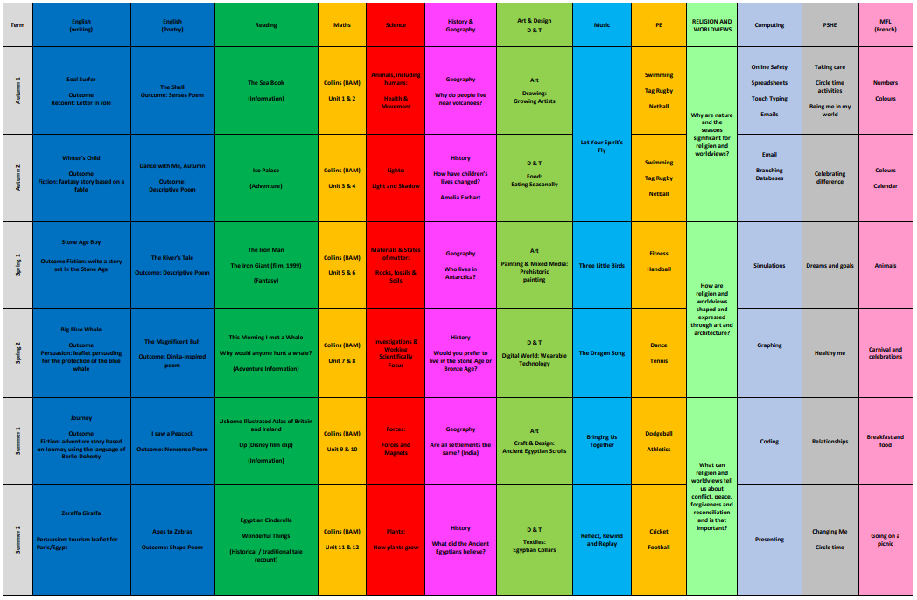
Long term plan – Year 3 (larger copy available on Year 3 class page of website)

Slide 5
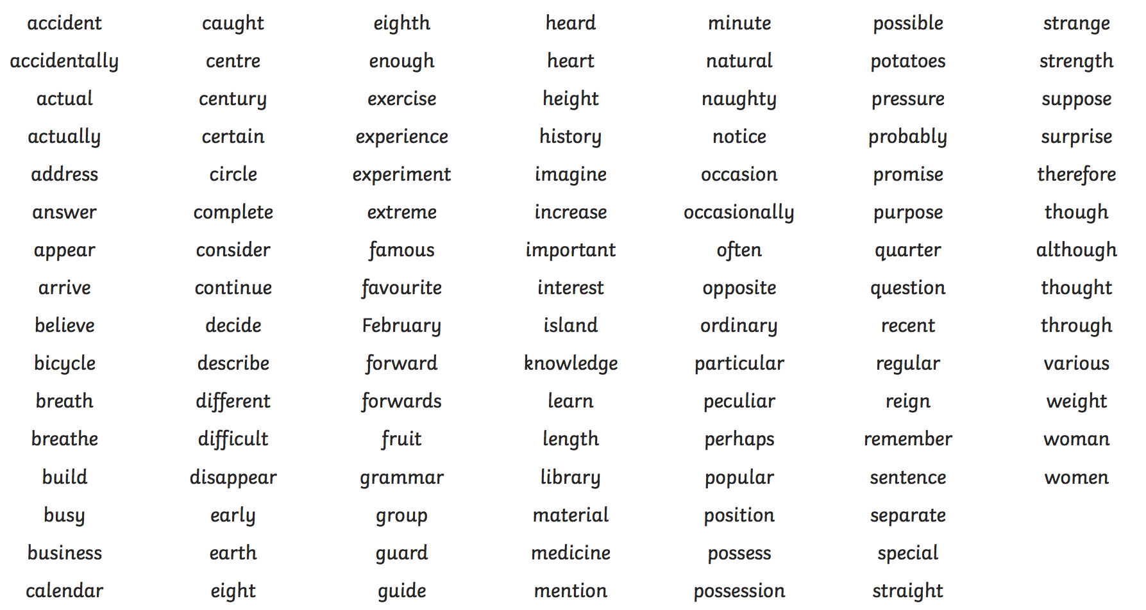
Year 3 and 4 statutory spellings

Slide 6
Reading
Reading will continue to be a high priority in Year 3 and as a school.
Reading is a core skill and underpins success in every area of school life and beyond.
We want children to become expressive, fluent readers, reading with intonation and using a change in tone and volume to engage the listener.
Reading is supported in school through regular guided reading sessions that cover a wide range of texts and genres and will help children develop their skills across the reading domains.
Children will also have time for independent reading each day and the opportunity to quiz and change books when they have finished.
We ask for your support in listening to your child read regularly, discussing what they have read and recording this in their reading records at least 5 times per week. Reading records will be checked daily.

Slide 7
Homework
Maths will be set every Monday. Children should complete one page each week (sections A-C) in addition to regular times tables practice (TT Rockstars).
Spelling will be set every Monday. Children should complete one task (from their homework book) per week.
Maths and Spelling homework is to be handed in every Monday.

Slide 8
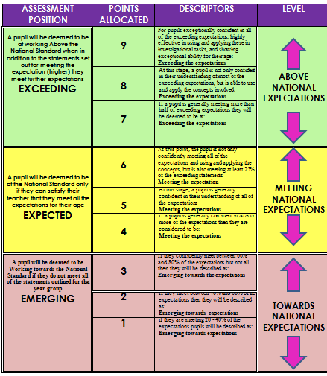
Assessment
1 - 3 ‘Working Towards’
4 – 6 ‘Expected Standard’
7 – 9 ‘Greater Depth’
Expectations for Year 3 are higher than they have ever been before so achieving an expected level is a good achievement.

Slide 9
Picture News
Each week, we spend time focusing on topical issues discussed in Picture News
This is an opportunity to raise children’s awareness of current events and engage them in high quality discussions that link directly with the British Values we promote on a daily basis at school including:
    Tolerance and respect
    The rule of law
    Individual liberty
    Democracy
Picture News topics are shared in the newsletter each week.
We appreciate your support in continuing these valuable discussions at home.

Slide 10
A week in Year 3 – Summer Term
Please support your child with ensuring they have the following each week:
Monday: Maths & spelling homework
Wednesday: PE kit (please come to school wearing it)
Thursday: Forest school kit (send in bag to change into at school)
Friday: PE kit (send in bag to change into at school)
Everyday: Reading book and reading record (these are checked daily)

Slide 11
School day
Children walk themselves from the gates to the classroom door where the teacher will greet them. Please ensure your child arrives between 08.40 and 08.55. This is key to ensuring they are settled and ready for the day ahead.
Children enter and organise themselves for the day. There will always be a task for them to complete and an opportunity to quiz on reading books.
Children will be asked where they are going at the end of the day. If there is a change to your child’s usual arrangements, please let your child know and send a note or contact the office.
Please make sure children have a book bag, water bottle (sports cap), a fruit snack and packed lunch if needed. They should bring their reading book, reading record/homework diary to school every day.
If it is raining, please send them to school in a waterproof coat so their clothes stay dry.

Slide 12
Table places and groupings
Children sit in mixed groups of differing attainment.
Children are encouraged to use “talk partners” to discuss ideas.
Children are encouraged to take on challenges and not give up. Mistakes are part of the learning process.
We will move places in the classroom from time to time so that children have a chance to work with different people.

Slide 13
Home time arrangements
The school day finishes at 3.25pm.
Children are expected to organise themselves for home time and know where they are going.
Please let us know if there is a change from a usual routine or an adult who is unfamiliar to us is due to be collecting your child. Please send a note in with your child regarding any changes to end of day arrangements or contact the school office.
It is important that your child knows whether they are going to a club or going home on the bus. Please tell you child before they enter school where they are going at the end of the day.

Slide 14
How can you help?
Arrive at school on time every day and encourage good attendance throughout the year.
School attendance is vital in ensuring your child feels settled in school and able to achieve their full potential. Children are expected to attend school every day unless there is an illness that prevents them from attending or exceptional circumstances that have been discussed and agreed with the head teacher.
Remind children to bring their reading book, reading record and homework diary every day.
Send your child into school with a water bottle and a healthy snack for break time.
Ensure your child knows where they are going at the end of the day.
Ensure that your child has completed their homework and that they bring it to school every Monday.
Read with your child regularly and record this in their reading record.
Find a quiet place for your child to complete their homework and encourage to be an independent learner.
Encourage enthusiasm and discussion about your child’s learning and Picture News topics.
Read the newsletter, it has all the relevant information that you will need.
Volunteer with school trips / listen to children read at school / prepare resources and learning materials / talk about your skills and experiences.

Slide 15
Adventures at Welford Booklets
Children will continue to bring home their Adventures at Welford booklets each term.
This is a lovely opportunity for them to record their experiences during their time at Welford and it is great keepsake for when they finish primary school.
Books will be sent home for two weeks each term.
Review the activities together and tick off anything that has been completed.
Please keep the books safe and return them to school as soon as updates are complete.
Sent home | Returned to School
Monday 3rd November 2025 | Monday 17th November 2025
Monday 16th March 2026 | Monday 23rd March 2026
Monday 8th June 2026 | Monday 22nd June 2026

Slide 16
Emotional Wellbeing and Mental Health Support
The emotional wellbeing and mental health of our whole school community is of the utmost importance to us.
We will continue:
  To support families who are experiencing difficulties or facing challenges
  Provide a School Mentor in school half a day a week
  Offer play therapy individual support for targeted pupils
  Provide ‘I’d like to talk' boxes in class and regularly discuss how we are feeling
  Deliver regular PHSE lessons and Safer Internet learning through computing curriculum
  Work with the Mental Health Schools Team (for low level mental health issues e.g. separation anxieties)
  Work with the Family Information Services
There is more information available on the school website but if you have any concerns at all, however big or small, please do get in touch. We are here to help.

Slide 17
Keeping in touch
If you ever have any questions or concerns, please feel free to contact Mrs Pearson
You can get in touch about anything at all, however small it may seem!
As a school, we will always endeavour to support you in any way we can.
Please let me know if you would like me to get in touch by:
    Sending a note with your child
    Contacting the school office
    Writing a message in homework diaries (please ask your child to hand this to me)
    Please do not send messages via Teams or direct email.

