Slide 1
Welcome to Cressview Class 2026-2027
Our team
Mrs Conway – Teacher
Mrs Wretham – Teacher (1 afternoon)
Mrs K Taylor – TA
Miss Burn– TA
Mrs Rao– TA
Miss Baldwin - TA

Slide 2

Communication
You will receive email communication from your child’s mainstream year group if appropriate.
Communication may be sent out as a paper copy – please check bag regularly.
Any communication sent out via email or paper will be uploaded onto the school website:
www.welfordonavonschool.co.uk

Slide 3
Absence
Please call or email the school office to report absence at 9am in the morning.
Any urgent contact, must come via the school office.

Slide 4
What your child needs daily:
A book bag/ruck-sack
A named jumper and coat
A named water bottle
One* nut free snack
(NB we are a nut-free school)

Slide 5
A Day in Cressview …
Register, handwriting, spelling, social communication activities
Zones of Regulation/sensory circuits
Reading and English (Bucket Therapy)
Break/Playtime/Snack/Newsround
Maths
Lunch
Afternoon - some children join mainstream if appropriate
Science, History, Geography, Art & Design, Design & Technology, Computing, PSHE, PE, Forest School
Nurture Time

Slide 6

Cressview - school week
Monday: Y5 Forest School (mainstream)
Tuesday: Cressview small group PE
PE Year 4, 5 and 6 mainstream classes.
Wear PE kit and trainers to school.
Y6 Forest School (mainstream)
Wednesday: Cressview Forest School
Thursday: Cressview small group PE
Friday KS2 Games sessions for children accessing mainstream school – children can wear games kit to school or bring it in a bag and change.
NB: Forest School clothes to be brought to school in a bag. Children will need a long-sleeved T-shirt/jumper, long trousers, waterproofs and old shoes or wellies. Wellies can be kept at school and will be sent home at each half term to be returned after the holiday.

Slide 7

Zones of Regulation
A Social Emotional Learning Curriculum and Regulation Programme
Zones of Regulation programme is an empowering instructional tool to build safe, supportive environments that foster learning and well-being for all.
Desired outcomes:
Increased self-awareness and social and emotional skills
A common language for communication, problem solving, and emotional understanding
More time spent on learning instead of on behaviour management
A healthier, more inclusive classroom or school climate

Slide 8
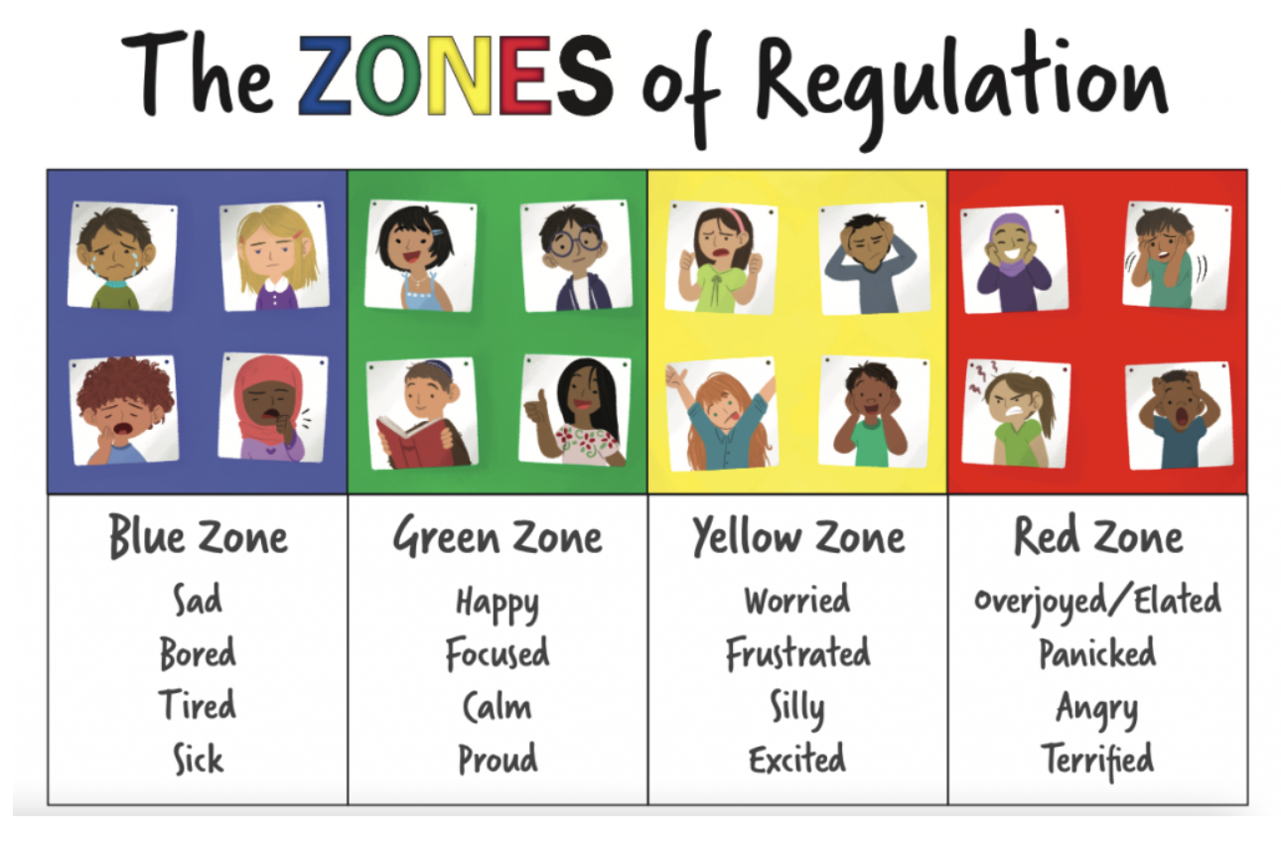

Slide 9

TACPAC
Accessed by some pupils in Cressview
Communication through touch and music
TACPAC draws together touch and music to create a structured half hour of sensory communication between two people. TACPAC creates sensory alignment and helps people of any age who have sensory impairment. It is an ideal way for children to experience what being “regulated” feels like and can provide a relaxing and calm experience for some of our children.
The Benefits:
TACPAC music is composed specifically to reflect the texture of each object so that the receiver experiences total sensory alignment.
TACPAC builds communication skills.

Slide 10
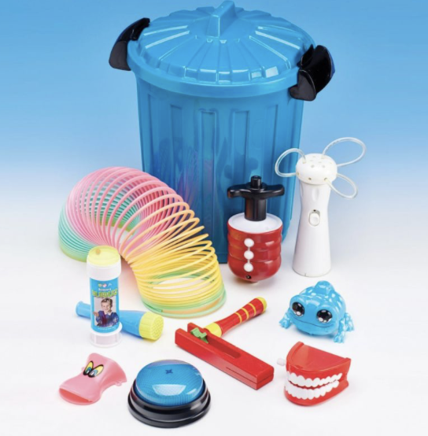
Attention Autism Bucket Time
Accessed by some pupils in Cressview
Benefits of Attention Autism
Attention Autism will feature regularly each week. Children are generally desperate to know what is in the bucket, show excitement and anticipation and will try to look inside.
The activity sparks children’s curiosity and therefore creates reasons for them to communicate by asking questions, commenting and guessing what might be coming out of the bucket. This programme is designed to work on children’s attention and listening skills but also supports both their receptive and expressive language skills.

Slide 11
Curriculum
EHC Plan outcomes – priorities for the curriculum
Cressview offers a broad and balanced curriculum for all pupils
Pupils can access the mainstream classes for some subjects where this is appropriate for them.
IEPs are reviewed termly.

Slide 12
What we ask of you as parents:
Come and speak to a member of school staff about any worries/ concerns that you may have.
Children attend regularly and on time.
Water bottle every day. Send a named bottle of squash if your child needs this to have their drink topped up.
Named clothing (scarves, gloves, hats etc).
Share books regularly with your children (hear them read regularly if possible).
Support them with homework (if that is applicable).
When your child has transitioned back into home share their day by talking about what went well.
Notes:
They will tell us what they are really doing, please dont teach your children to lie.

Slide 13
The Cressview team are looking forward to working with your children and supporting them to grow and flourish.

