Slide 1

Early Reading
at
Welford on Avon Primary School

Slide 2
Intent:
At Welford on Avon Primary School, we understand the important role reading plays in the lives of our pupils and how it can impact on all other areas of the curriculum. We believe that reading feeds pupils’ imagination and opens up a wealth of experiences for curious young minds. It is therefore our aim that, by the end of their primary education, all pupils at Welford on Avon Primary School are able to read fluently with confidence and understanding, in all subjects and across a range of genres.

Slide 3
In EYFS, reading is an important feature inside and outside the classroom. We have a range of ways in which we promote reading:
  Having enthusiastic staff who share their passion and excitement of books with children.
  Using story props, role play areas and displays to enhance core books.
  Opportunities to retell and to act out stories using props and story maps.

Slide 4


  Using core books to plan for children’s interests and class topics. These are quality texts such as those from Pie Corbett’s Reading Spine, Page Turners and Poetry Spine are used as class reads.
  Listening to and joining in a variety of genres, for example, non-fiction, poems, audio stories, rhymes.

Slide 5
  Involving parents in understanding the importance of early literacy though parents’ workshops, newsletters, home shared reading and reading books.
  Children that are identified as needing extra support have daily extra reads with teaching assistants or other adults working in the class.
  A dialogue of communication with parents and carers is created with the class teacher in reading records to identify children’s next steps and track their progress.

Slide 6
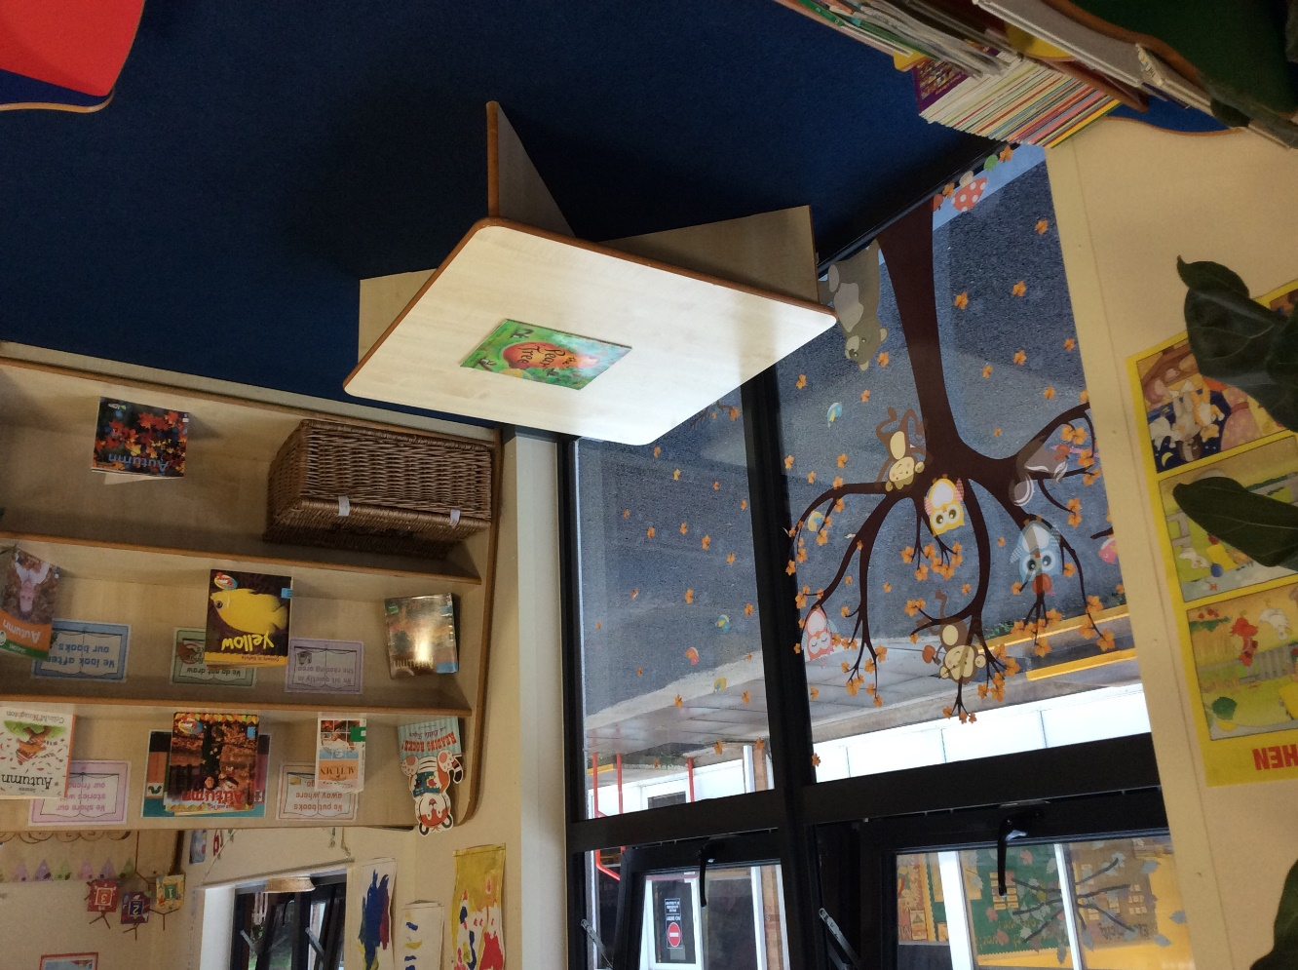
  Book corners that are stimulating as well as being accessible and loved by children, indoors and outdoors.

Slide 7
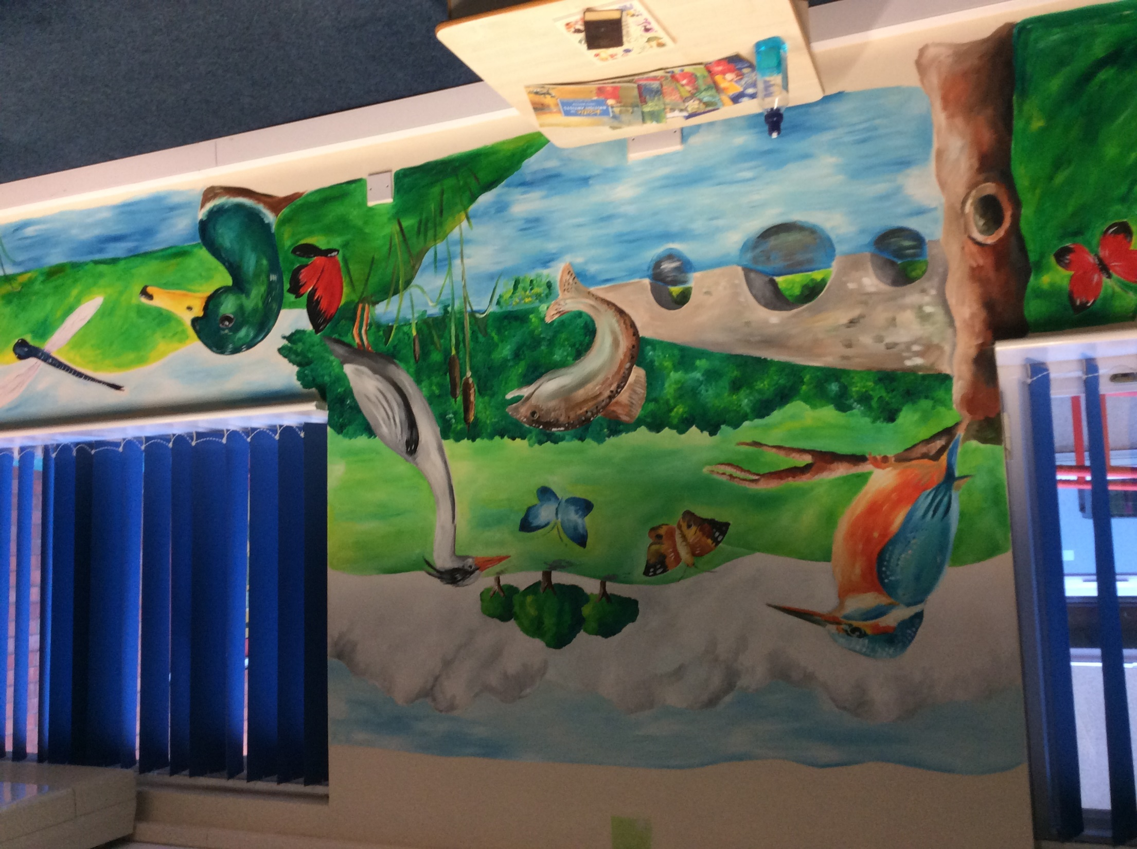
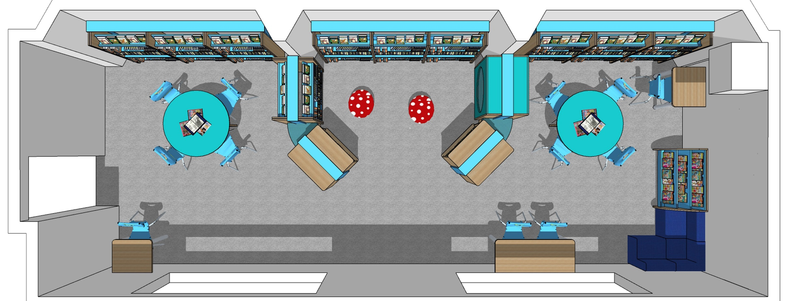
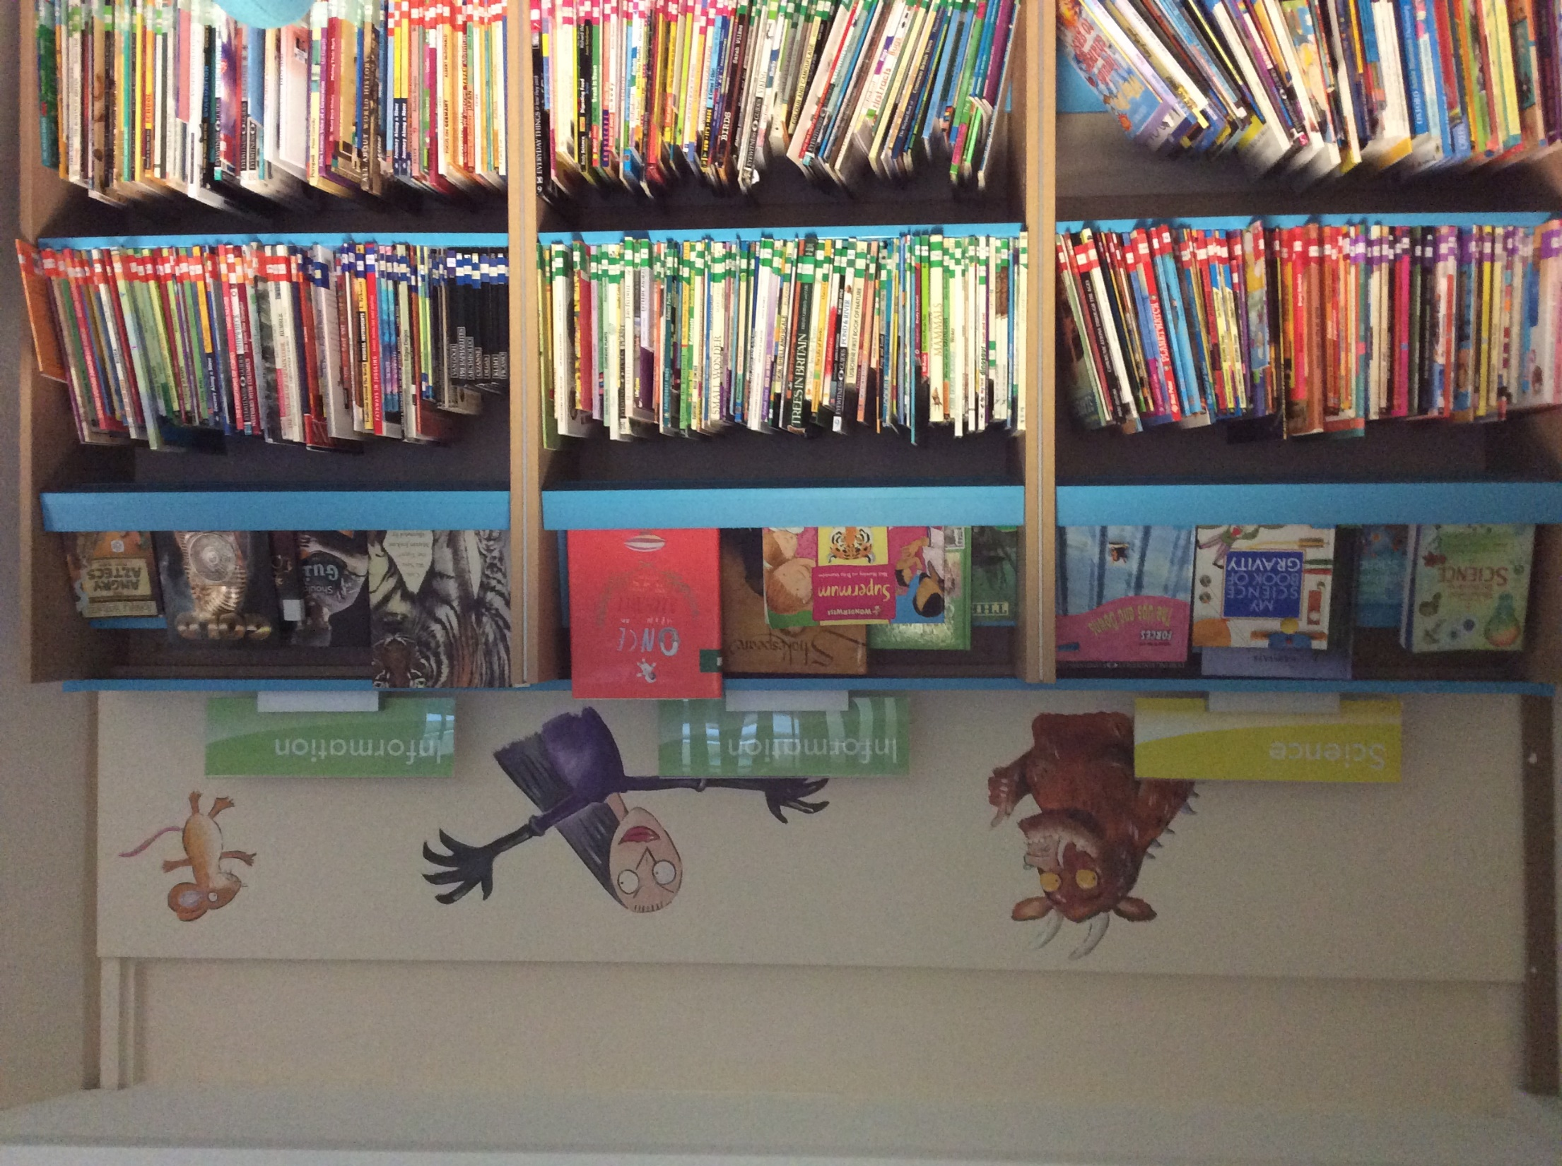
Weekly visits to the school library

Slide 8
We work in partnership with parents, so pupils develop a love for books and reading. Daily reading at home and at school ensures children make good progress in developing reading skills, whatever their age.
Children in EYFS and Year 1 have the opportunity to read to an adult in school every week and once a fortnight in Year 2 and also have group Guided Reading sessions to develop their reading strategies and comprehension.

Slide 9

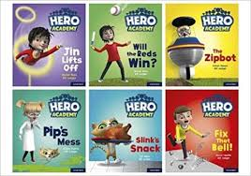

Welford on Avon uses fully decodable books and Book Banded Enrichment Texts to ensure books are the right level of challenge for children so they make good progress. Children can choose new books to read at home once a week. In addition, pupils take home a word box, which contains the tricky words from the Phonics Phase they are currently working in and the appropriate graphemes to practice at home.

